Slide 1
How Do I Search For a Book in Destiny? For Elementary Students
By Julie Papperman

Slide 2
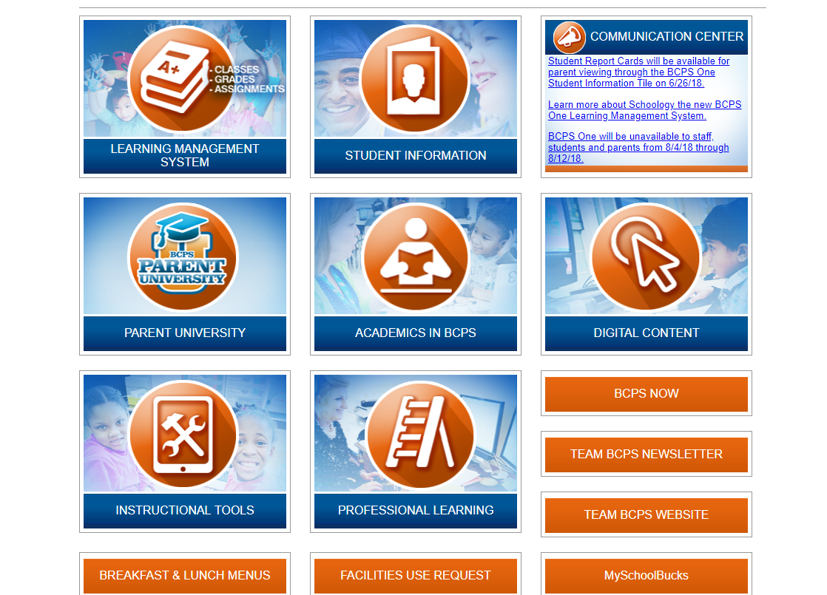
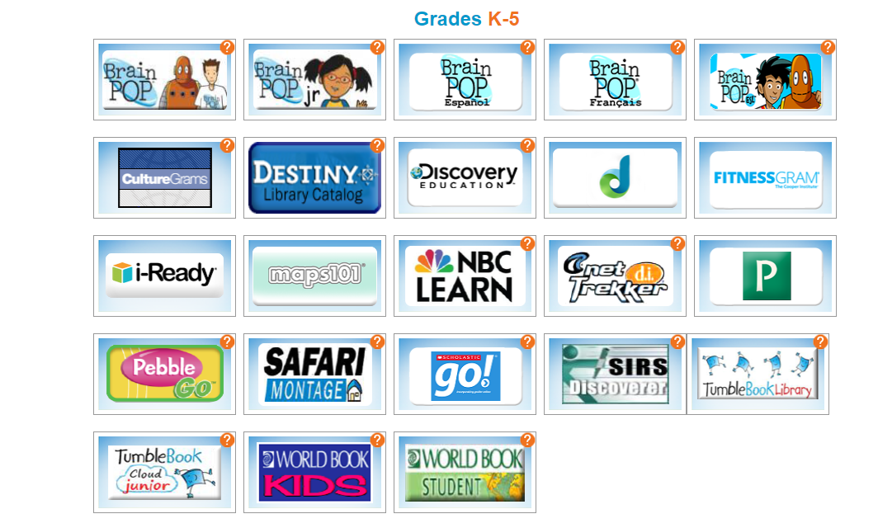
Getting to Destiny
After you log into BCPSOne, click on Digital Content and then on Destiny.
Step 1
Step 2

Slide 3
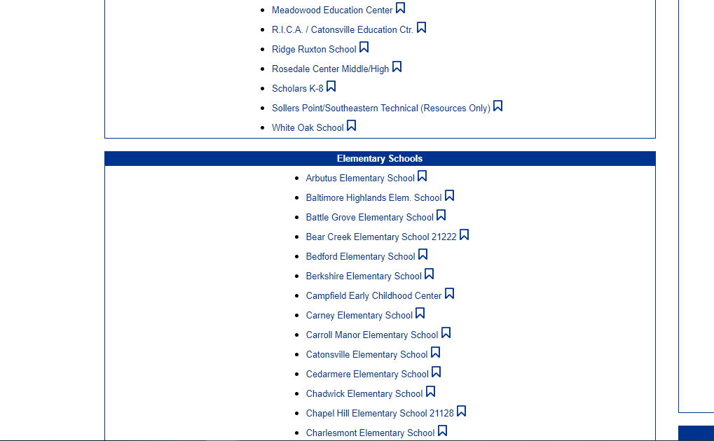
Choose your school from the elementary list. You may need to scroll down to find it.

Slide 4
What is a Keyword Search?
A keyword search looks for the word you type in any place on the book’s record.
Use a keyword search when you don’t know much about the topic you are looking for.
When you do a keyword search, you might get many results or you might get few results.

Slide 5
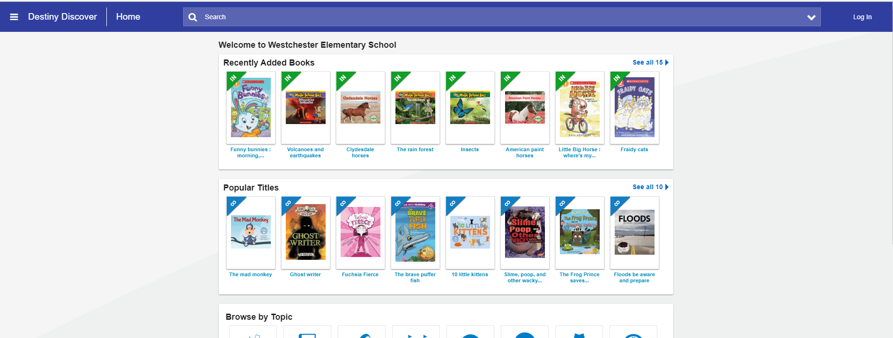
Doing a Keyword Search in Destiny
The search bar at the top is set to do a keyword search.
Type in the word you want to search.

Slide 6
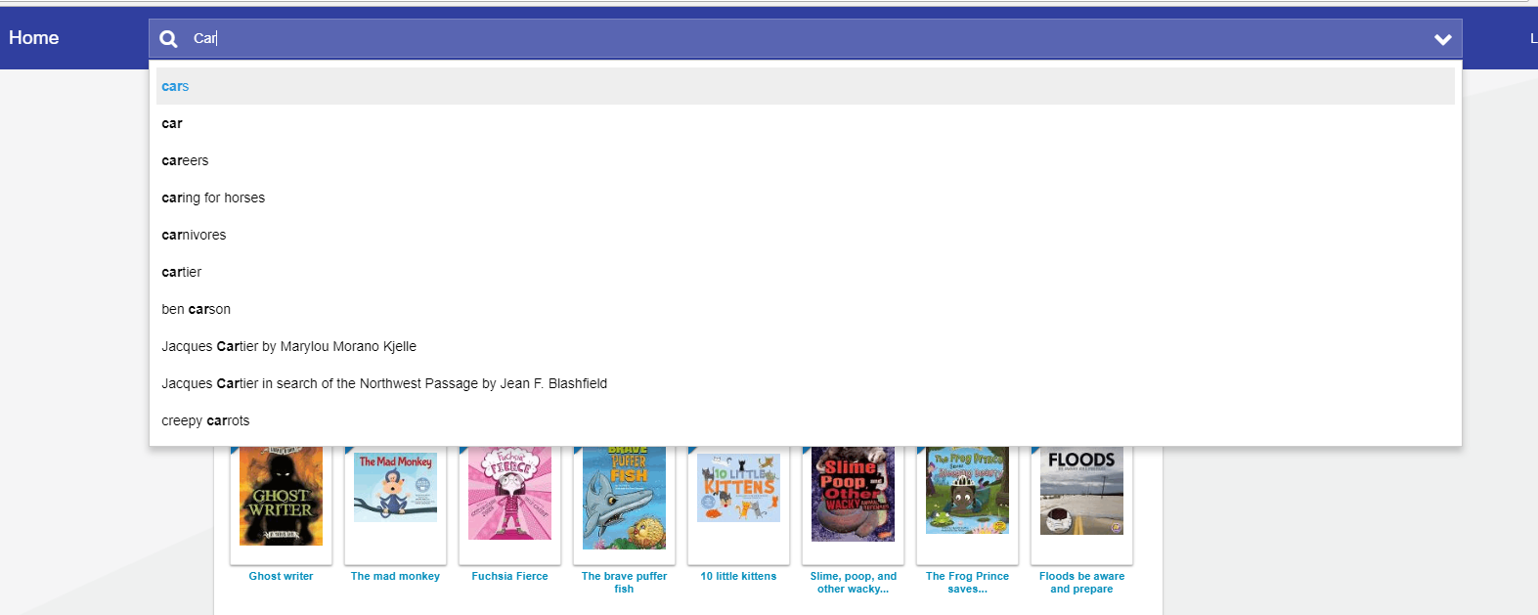
Other words that have the same letters show below as you type. This will help if you are unsure of how to spell the word.

Slide 7
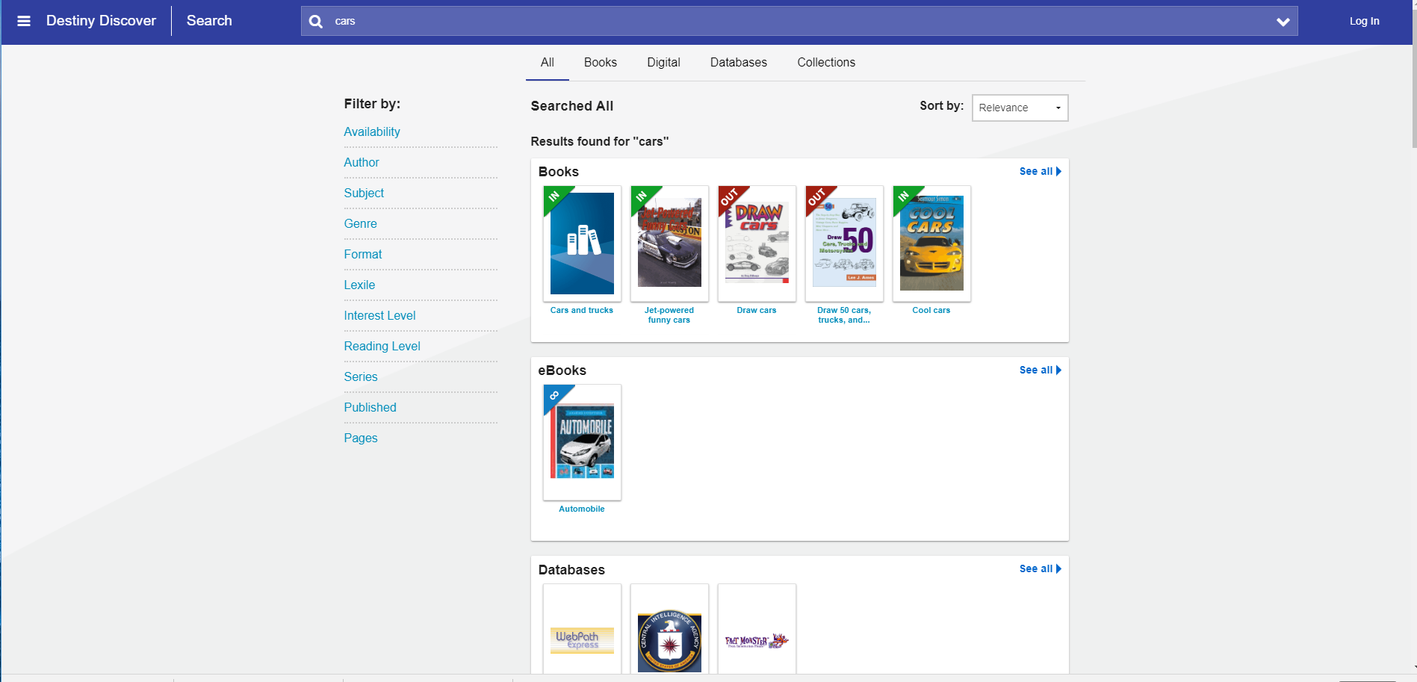
After typing in your word, Destiny will show you what the library has about your topic. Cars is the example shown.
You can choose to look for books, eBooks, or databases about cars.
Click the words “See all” to view each section.

Slide 8
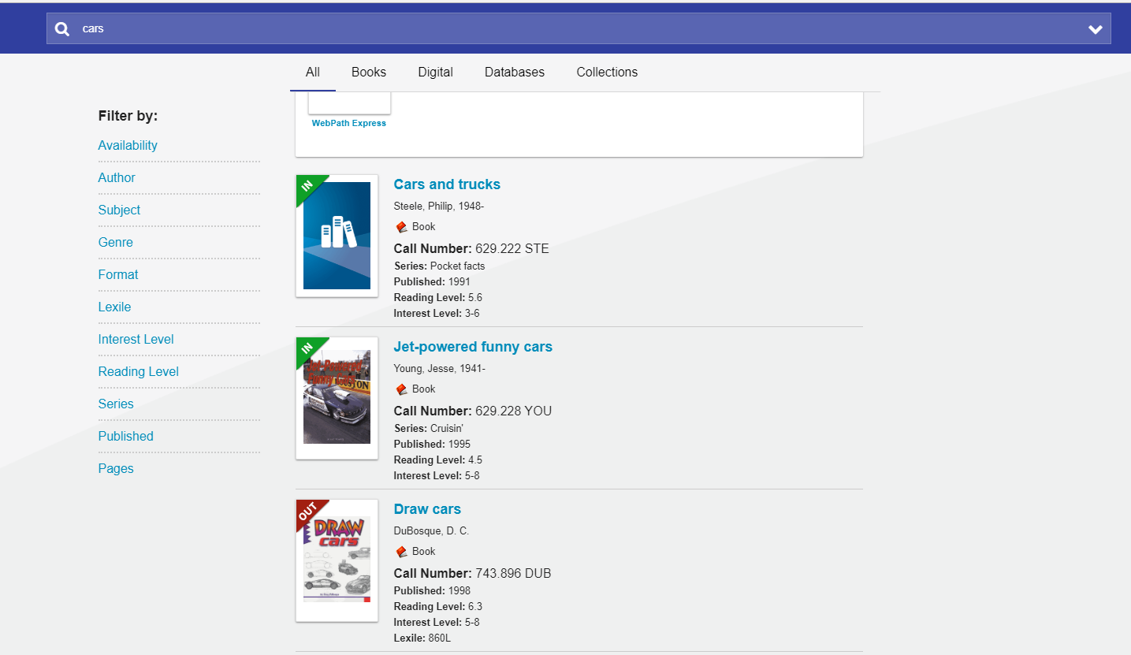
If you scroll down, Destiny provides a list of all the materials you can find in the library for cars. There are 61 items.
The call number tells you where to look on the shelf for the book.
Books are marked “IN” if they are available or “OUT” if someone has already borrowed it.
You can narrow your results by using any of the filters.

Slide 9
What is a Subject Search?
A subject search looks for the word you type in one place on the book’s record that tells what the book is about.
Use a subject search when you know the topic you want to find.
When you do a subject search, you will get results that closely match your topic.

Slide 10
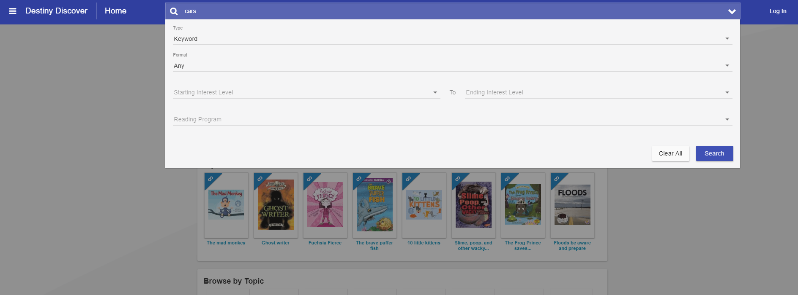
Doing a Subject Search in Destiny
To do a subject search in Destiny:
Step 1
Step 2
Type the subject word in the search bar.
Click on the arrow to bring down the menu.
Step 3
Click the arrow for Type.

Slide 11
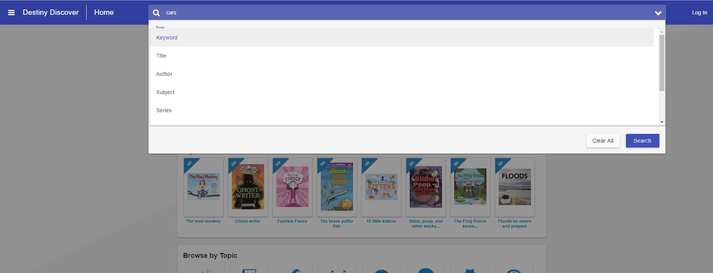
Step 4
Choose Subject for a subject search.
Step 5
Click the blue search button.

Slide 12
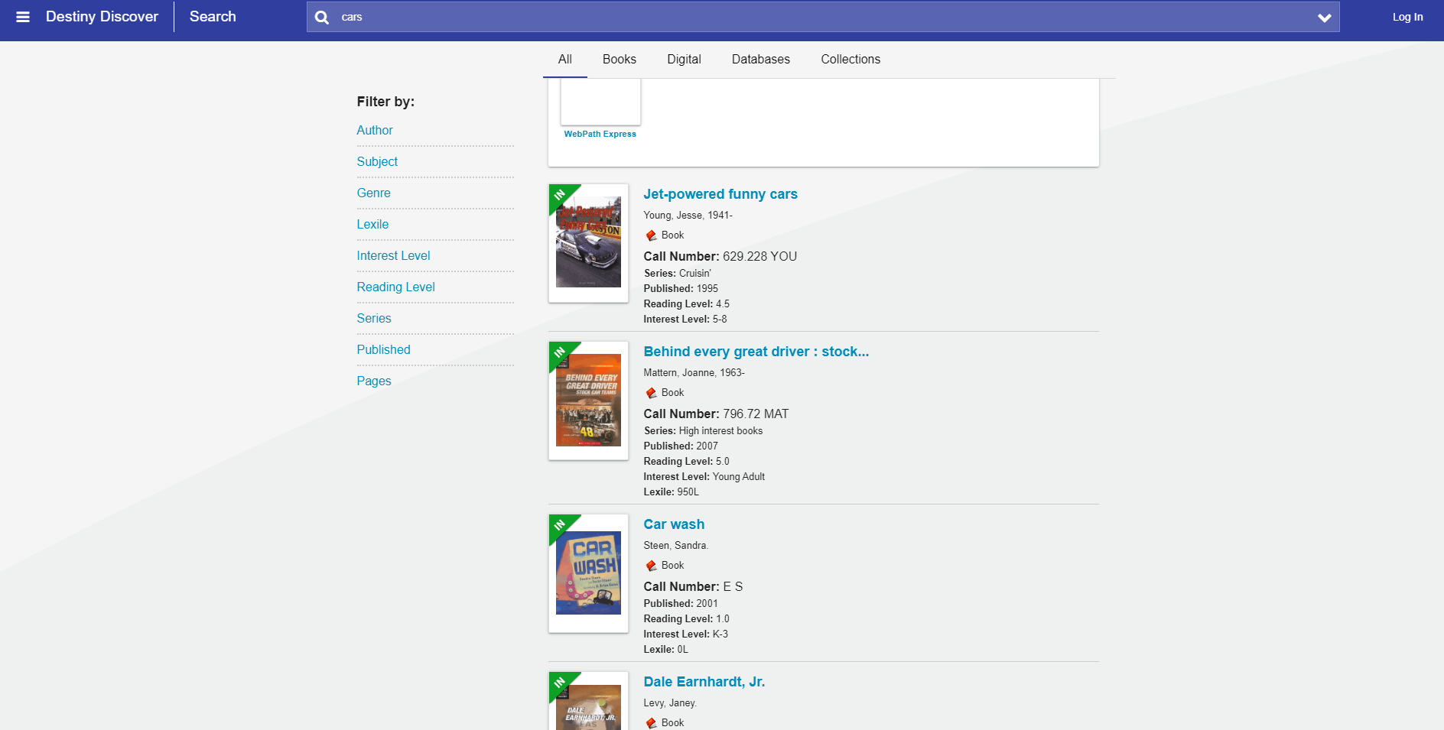
Results: Fewer items showed up with a subject search. There are 11 for cars.

Slide 13
Subject Search Tips
Searching by subject is not always easy. Here are some words to try for certain topics.
If you are searching for this topic, | Try this search instead
Sports Teams | Baltimore Ravens, Dallas Cowboys, New York Yankees
Tanks | Motor vehicles in war; Automobiles, Military; Vehicles, Military
Indians | American Indians, Indians – Civilizations, Indians of North America, American Aborigines
Cooking | Cookery, Cuisine, Food preparation
Jokes | Joke books, Wit and humor
Video games | Pokémon Go, Minecraft, Nintendo video games
Police | Cops, Law enforcement officers
Space Travel | Space flight, Rocket flight, Astronautics, Outer space --Exploration

Slide 14
Enjoy Searching!
If you have any questions, please ask your librarian. She will be glad to help.

